Slide 1

Azure For: Developers
Twitter: @ritasker
Email: ritasker8t2@gmail.com
Blog: richardtasker.co.uk

Slide 2
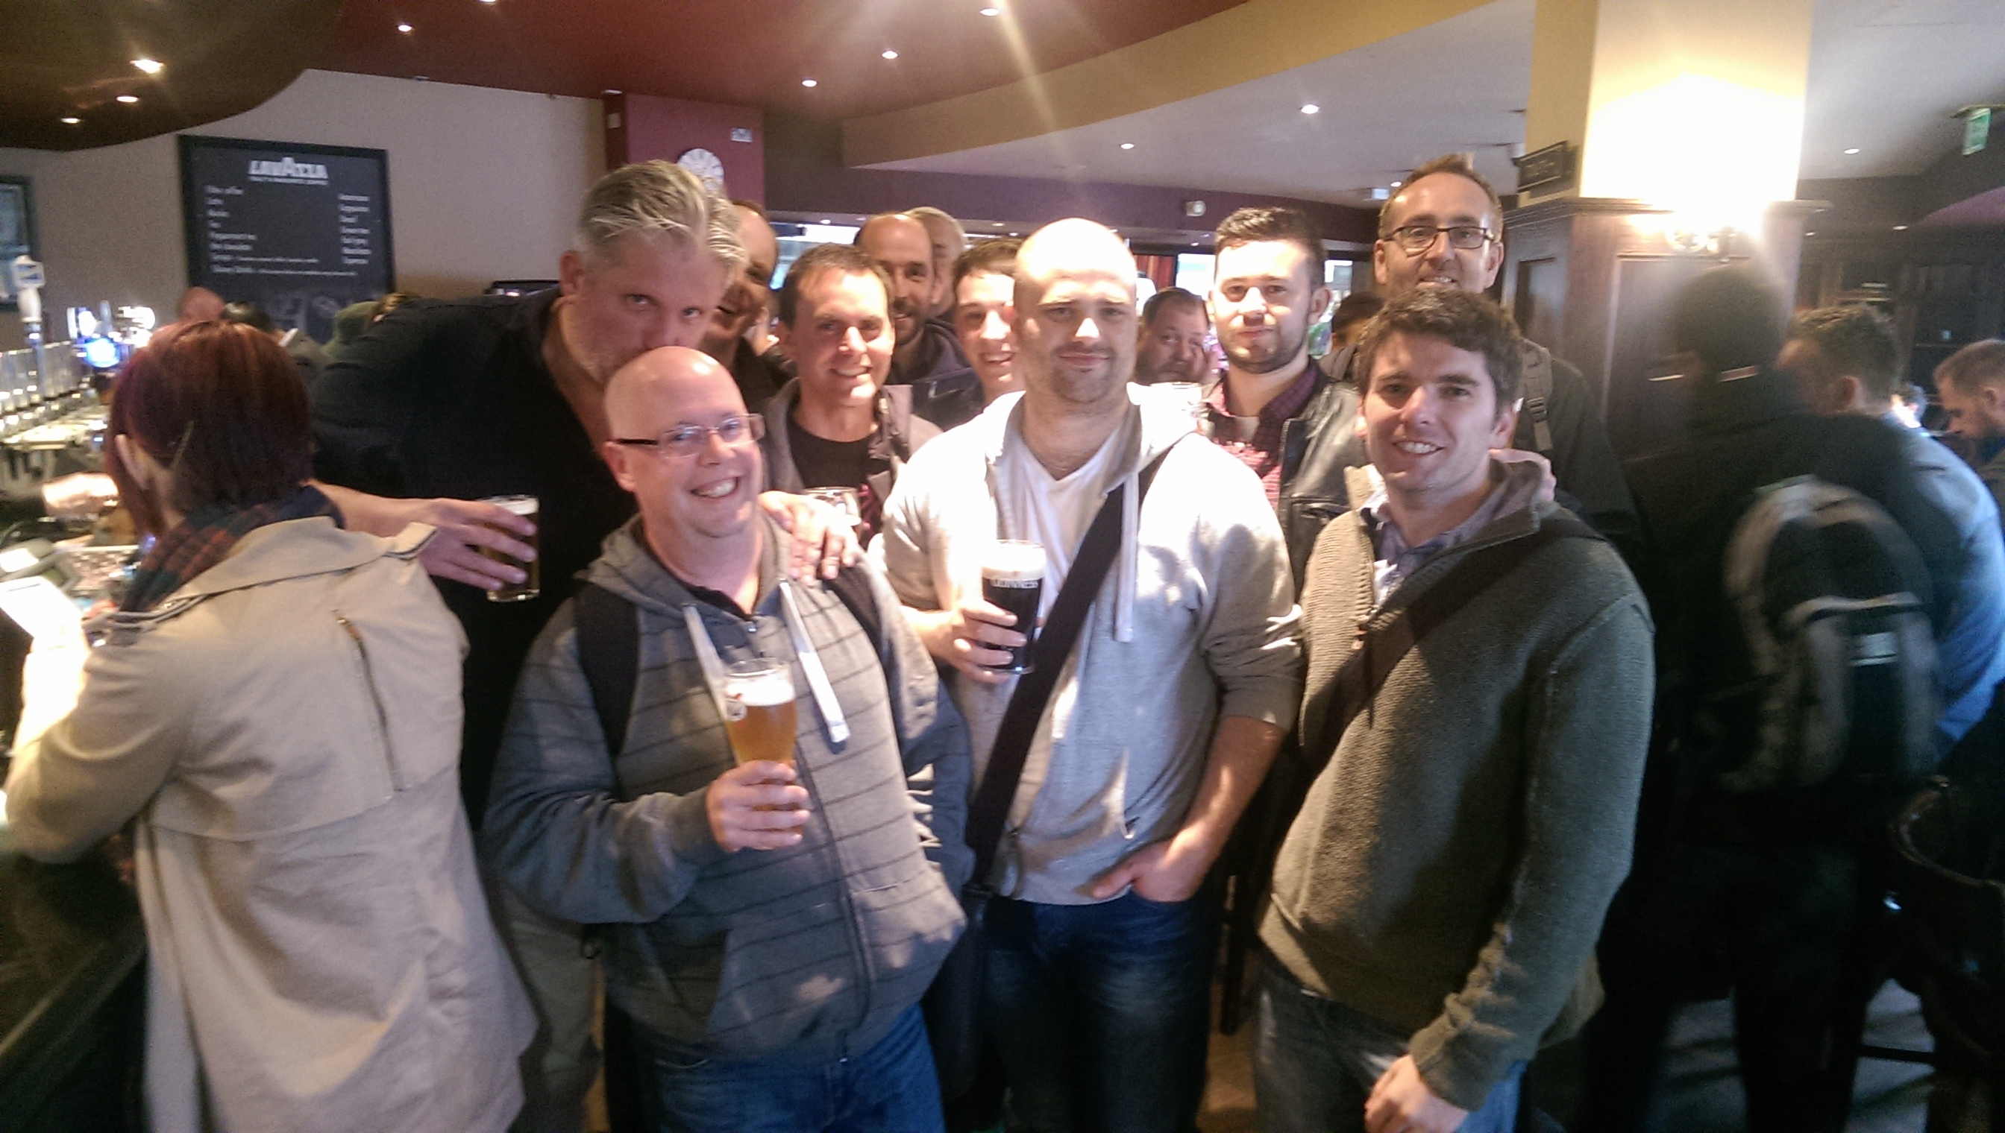

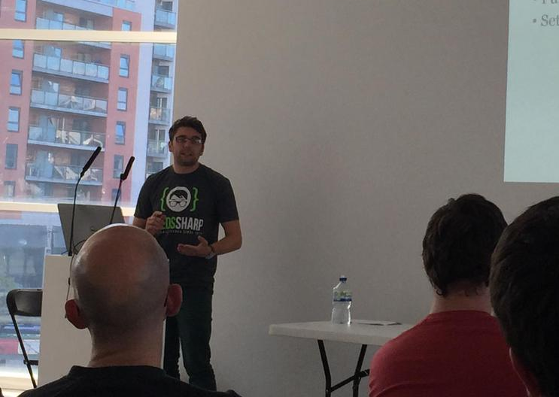
Why Me
.Net developer 10yrs
Last 3yrs Azure & cloud
Social startup
Spoken at conferences & user groups

Slide 3
Agenda
Getting Started
Deploying
Data Storage
Messaging
Notes:
Getting started
uBlogger – demo app
The Azure Portal
Create a WebApp
Deploying
Look at deploy options
Deploy via a local git repo
Data Storage
Look at what PaaS offering Azure has
We will look at each of them in the portal
Then implement one in our app
Messaging
Queues
And background tasks
Wont talk about
Service Fabric
Azure container services
Power BI – was hoping to but this talk is long enough

Slide 4


Demo
Notes:
uBlogger Tour
Azure Portal Tour
Create WebApp

Slide 5
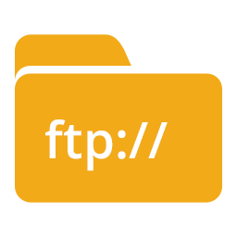
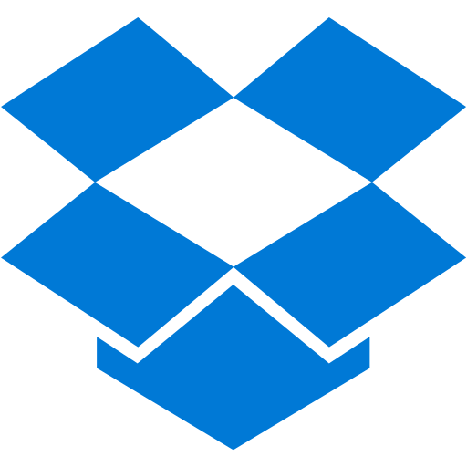


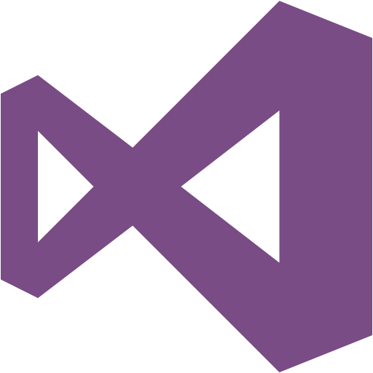
Ship It!
Notes:
Deployment options you can using in your workflow
FTP or cloud storage like dropbox
Local git repo
Cloud SCM like GH
Webdeploy
There is also Continuous Deployment, preview.
Build & test app
Deploy to dev environment
Gated promotions to prod
A customizable deployment pipeline in VSOL

Slide 6


Demo
Notes:
Local Git Repo Deploy

Slide 7


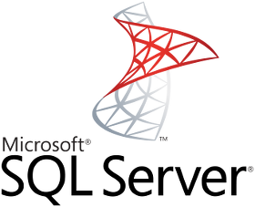
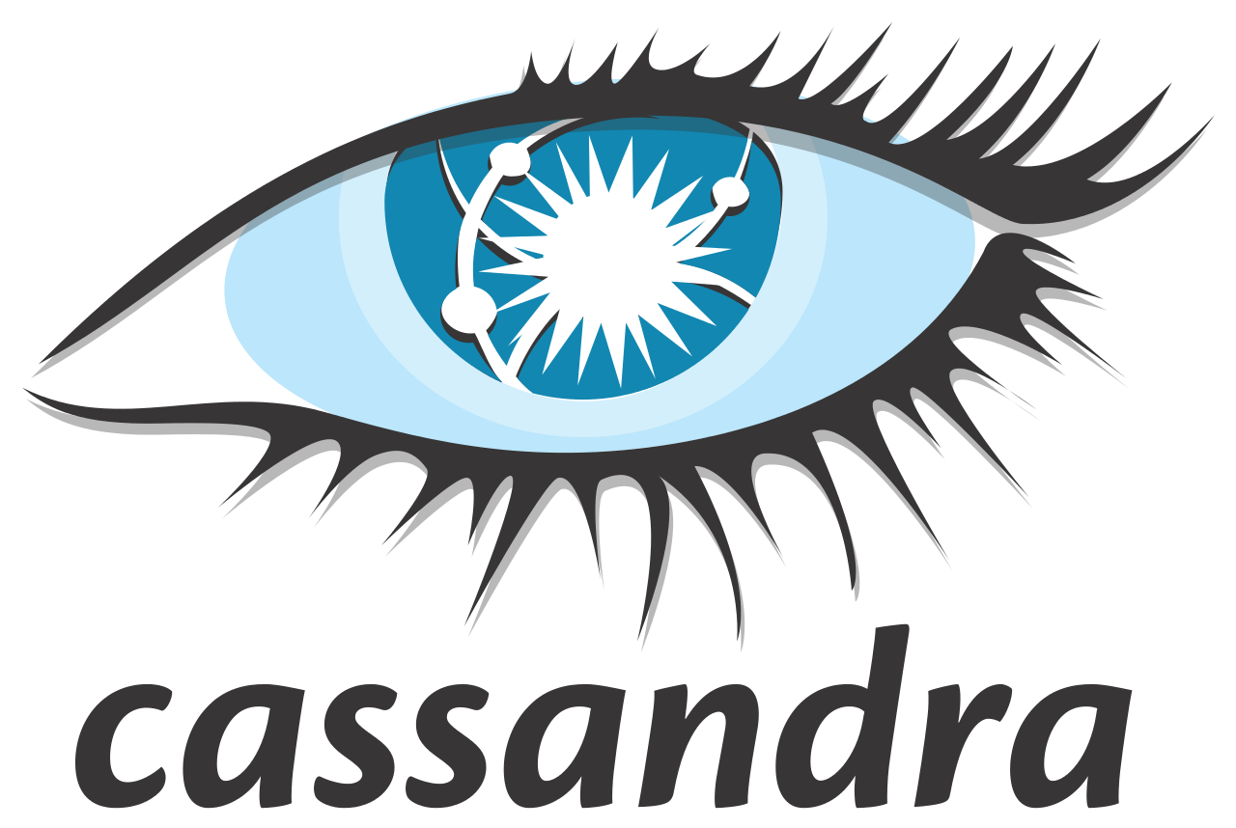
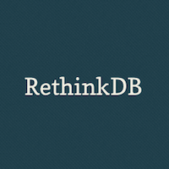


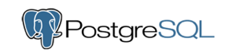
Data Storage
Notes:
DB families
Relational
Document
Column Store
Key/Value
Graph
App is using PG. Azure offers PG as a docker container & preconfigured VM image.

Slide 8




Data Storage
Notes:
Azure can cover you for 4/5 db families
SQL DocDb, Table Storeage Redis
Redis? StackExchange.Redis? Only the con str.

Slide 9


Demo
Notes:
SQL, DocDB & Table Storage Demo

Slide 10


Queues
Notes:
Business is booming, your app is well pops, your braking into smaller dedicated team. Or intensive process, data import video transcoding …
Message passing for IPC
Azure Service Bus
Queue Storeage

Slide 11
Azure Queue Storage
Simple, Fast & Reliable
Unlimited Queues
Unlimited Messages
64KB Message Size

Slide 12
Azure Service Bus
Brokered & Relay Messaging
Transactions, Dead Lettering, Message TTL
Queues, Topics & Filtering
Up To 1GB Message Size
Notes:
Relay
Azure to on-prem
One-way communication – trigger a process on-prem from Azure
Maybe you need to query data from on-prem RPC style
Or bi-directional
Better the direct HTTP IMO, but both parties have to be connected to the relay.
Brokered
Both parties don’t have to be connected
Common features, Pub/Sub, dead lettering
Core concepts
Queues, FIFO, ReceiveDelete, PeekLock
Topics route messages eg restaurant food to the kitchen or drinks to the bar
Filtering further level of routing based on message props.

Slide 13

Demo

Slide 14


Background Tasks
Notes:
Our app is publishing messages, nothing consuming
Exe in VM or in docker hosted ACS. Well that’s a talk on its own.
Cloud Service – Worker Roles or Azure Functions
Who wants to take a punt

Slide 15
Cloud Service – Worker Roles
RDP Access to VM
Web Roles & Worker Roles
Must inherit from RoleEntryPoint class
OnStart
Run
OnStop
Scales differently to other services
Notes:
We could use connect to the bus OnStart
The subscribe to messages & process them in Run
When you deploy a cloud service you configure how many instances on the VM
Then scale the number of VMs.
Great for compute intensive tasks, over kill for us.

Slide 16
Azure Functions
Next generation WebJob
Short, concise pieces of code
Can be written in numerous languages
Pay for what you use
Notes:
WebJobs?
Evolution of …
Easily writen & deply peices or functions
Dev only has to think of the task in hand.
2 hosting options
Consumption Plan – for short lived functions aggregates total compute of funcs
App Service Plan – Like web app, basic, std, premium, always on. Good for continually running funcs.

Slide 17

Demo

Slide 18
Summary
Creating & Deploying WebApps
Data Storage Services
Queuing & Azure Service Bus
Background Tasks & Azure Functions

Slide 19


Twitter: @ritasker
Email: ritasker8t2@gmail.com
Blog: richardtasker.co.uk

